Slide 1

Ho Chi Minh City University of Transport
Image Processing and Computer Vision
POINT OPERATORS & LINEAR FILTERS
Tran Le Anh
anhtl@ut.edu.vn
03-2025

Slide 2
Point Operators
Linear Filters

Slide 3
Point Operators
Linear Filters

Slide 4
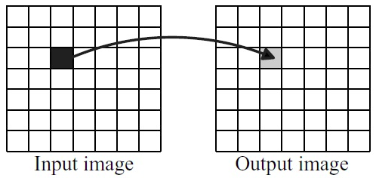
Point Operators
Definitions
(1) In image processing, point operators, also known as pixel-wise operators, transform an image by modifying each pixel's value based solely on its own value, without considering its neighbors or position.
(2) A point operator, denoted as Ψ, transforms an input image f into an output image g where each pixel's value in g is determined by a function ψ applied to the corresponding pixel in f. Mathematically, this can be expressed as: g(x) = ψ(f(x))

Slide 5
Point Operators
Examples
- Brightness Adjustment: Adding or subtracting a constant value to all pixel intensities.
- Contrast Stretching: Expanding the range of pixel values to enhance contrast.
- Histogram Equalization: Adjusting pixel values to have a uniform distribution of intensities and a flat histogram.
- Thresholding: Converting an image to a binary image by setting a threshold value.

Slide 6
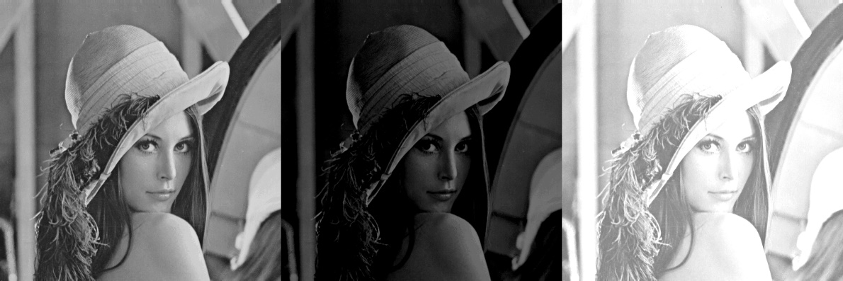
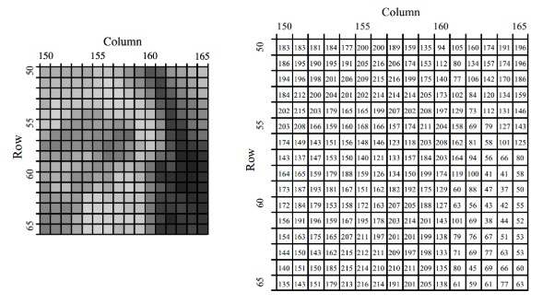
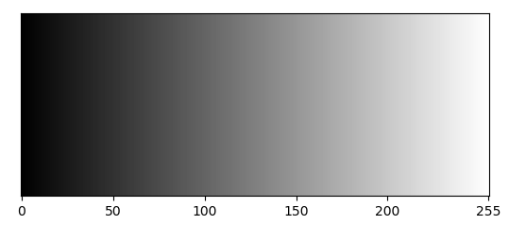
Point Operators
Brightness Adjustment
Ref: https://www.allaboutcircuits.com/technical-articles/digital-image-processing-point-operations/

Slide 7
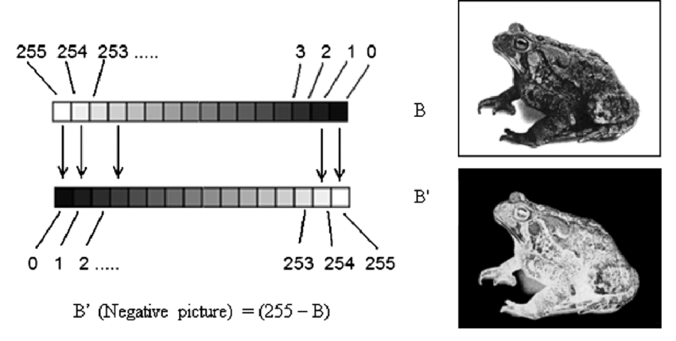
Point Operators
Brightness Adjustment

Slide 8
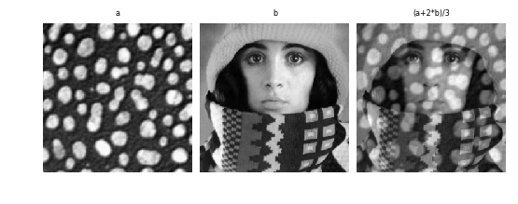
Point Operators
Brightness Adjustment
Image blending
Ref: https://staff.fnwi.uva.nl/r.vandenboomgaard/IPCV20162017/LectureNotes/IP/PointOperators/ImageArithmetic.html

Slide 9
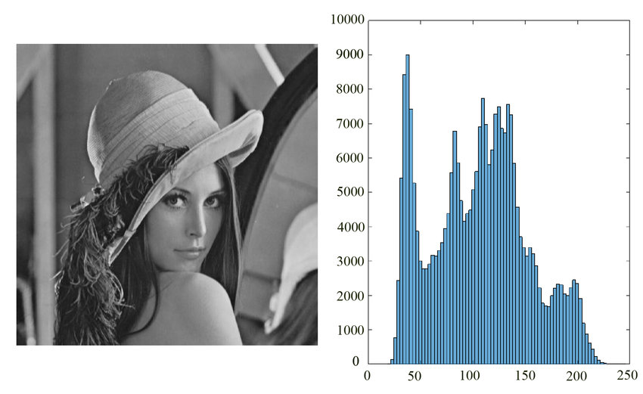
Point Operators
Histogram
An image histogram is a graphical representation of the number of pixels in an image as a function of their intensity.
Gray Image

Slide 10
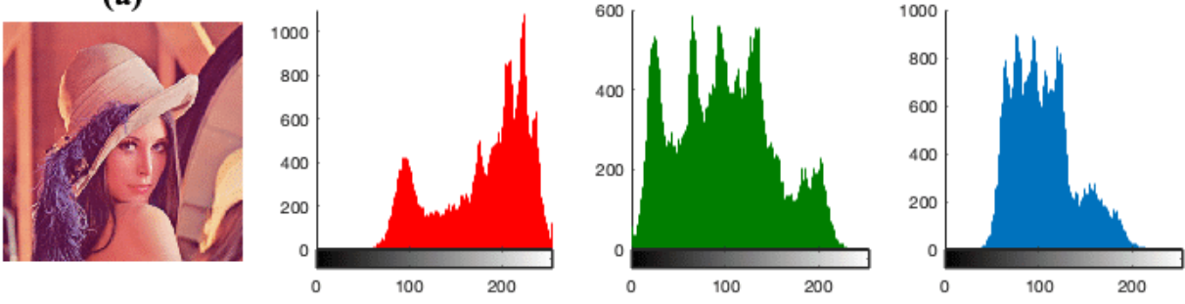
Point Operators
Histogram
An image histogram is a graphical representation of the number of pixels in an image as a function of their intensity.
RGB Image

Slide 11
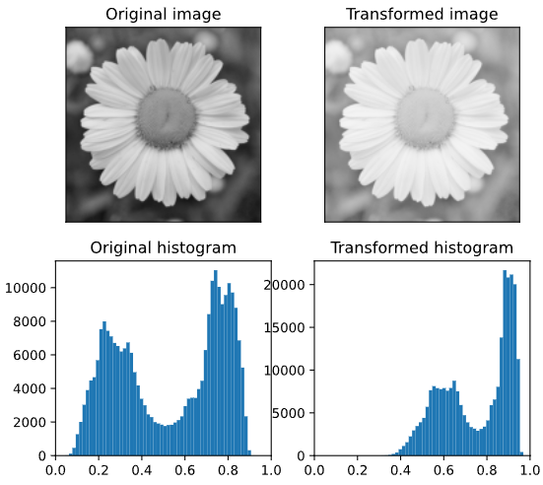
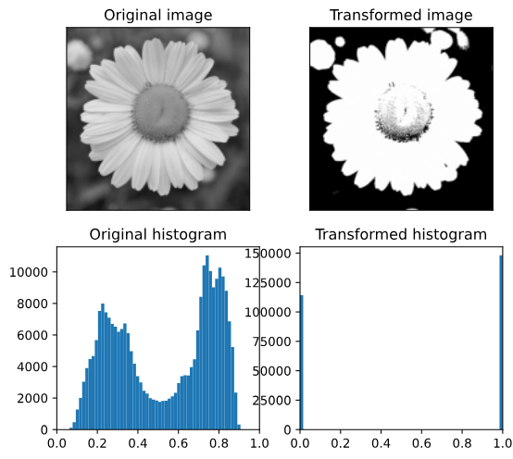
Point Operators
Histogram
An image histogram is a graphical representation of the number of pixels in an image as a function of their intensity.

Slide 12
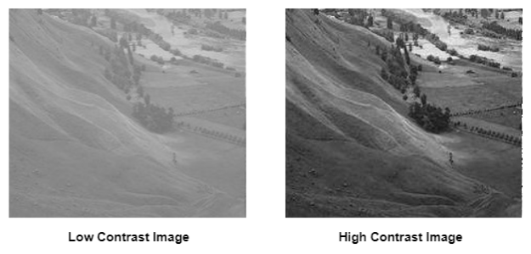
Point Operators
Contrast Stretching
Image contrast refers to the difference in brightness or color between different areas within an image, which determines how well those areas are distinguished from each other.

Slide 13
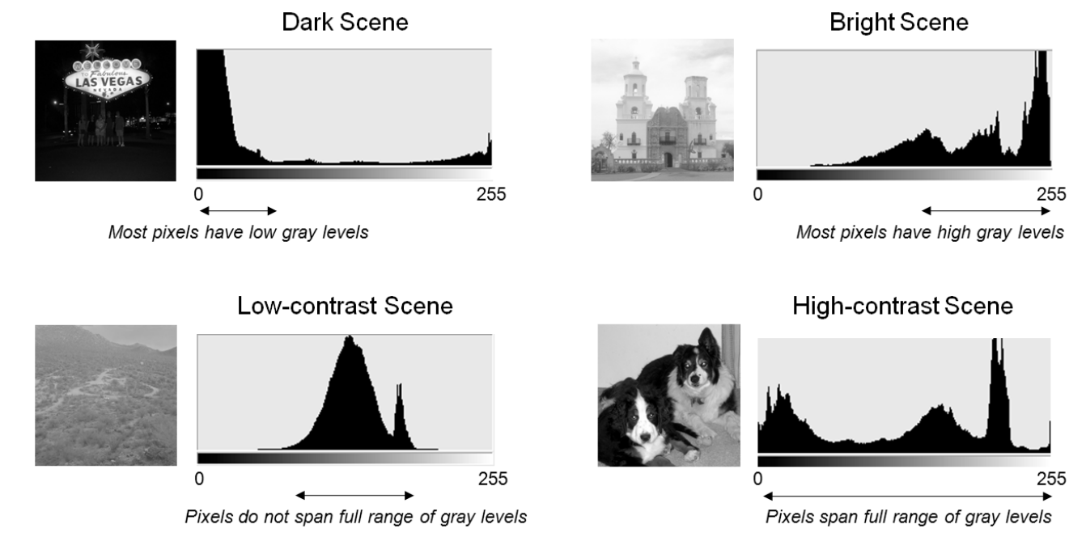
Point Operators
Contrast Stretching
Image contrast refers to the difference in brightness or color between different areas within an image, which determines how well those areas are distinguished from each other.

Slide 14
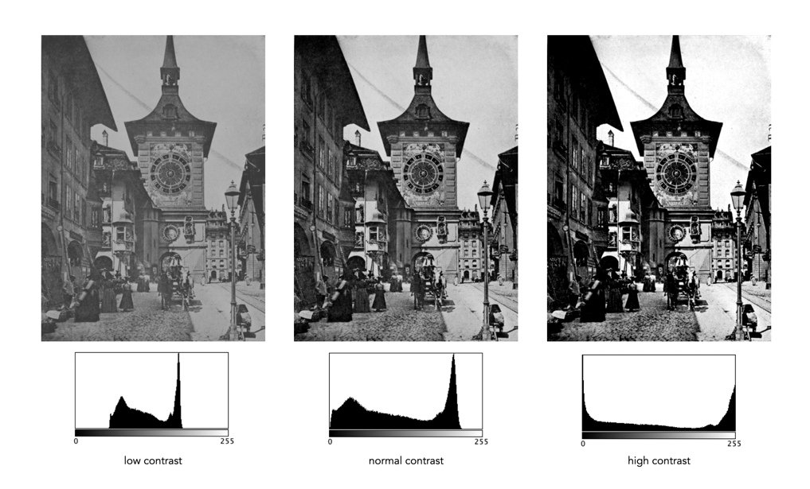
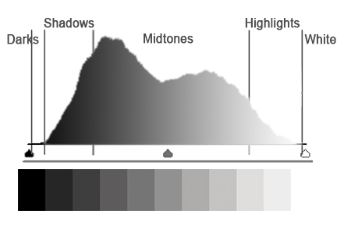
Point Operators
Contrast Stretching

Slide 15
Point Operators
Contrast Stretching

Slide 16
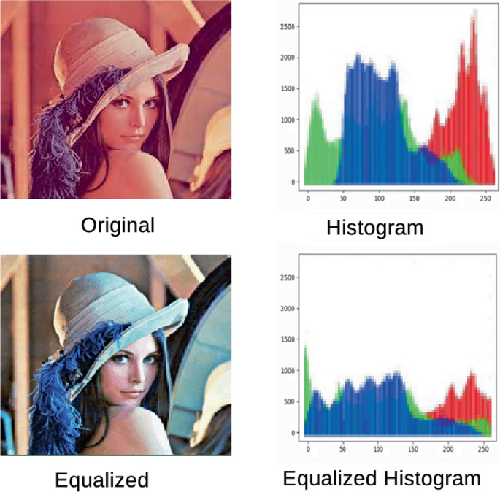
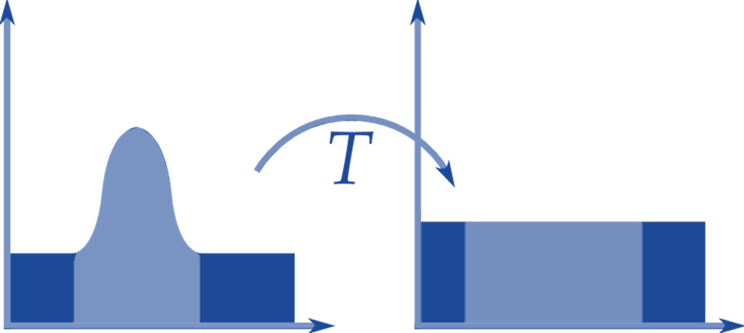
Point Operators
Histogram Equalization
Adjusting pixel values to have a uniform distribution of intensities and a flat histogram.

Slide 17
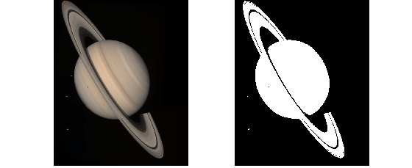
Point Operators
Thresholding
Image thresholding simplifies images by converting them into a binary format (black and white), making it easier to identify objects, extract features, and perform other image processing tasks.

Slide 18
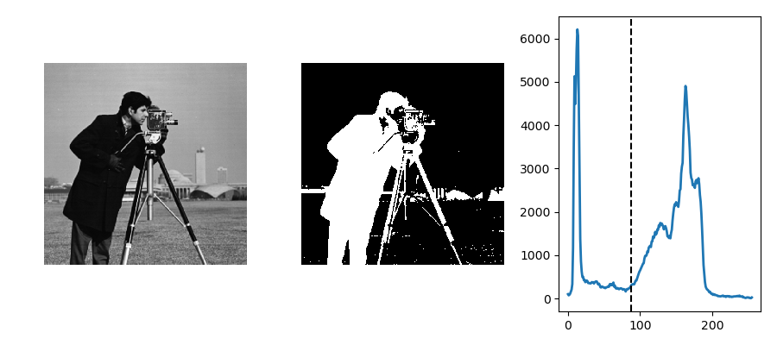
Point Operators
Thresholding

Slide 19
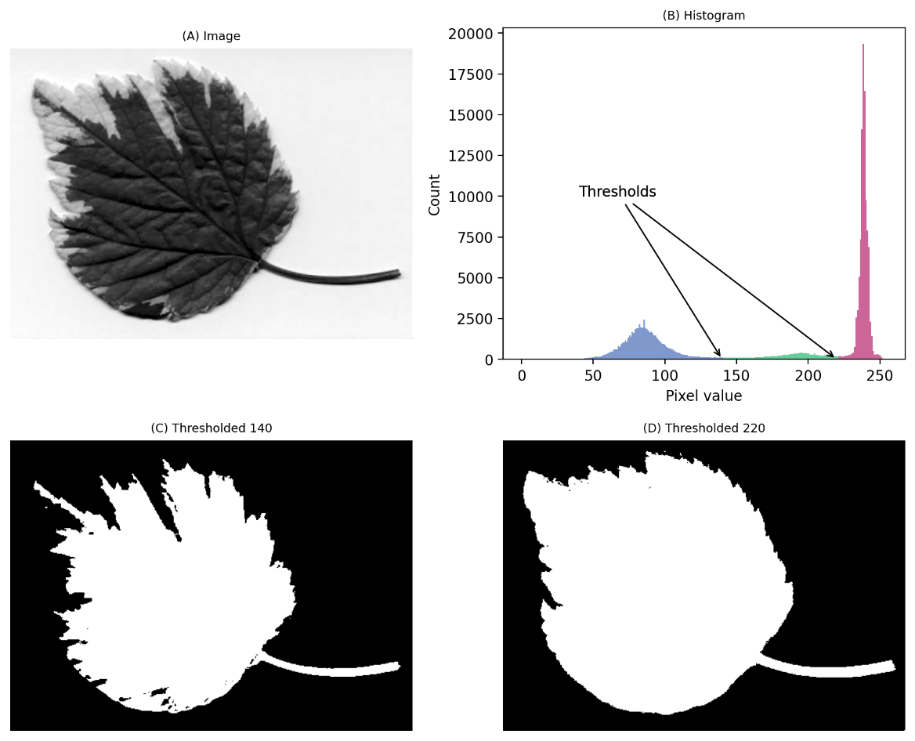
Point Operators
Thresholding
High Threshold
Low Threshold

Slide 20
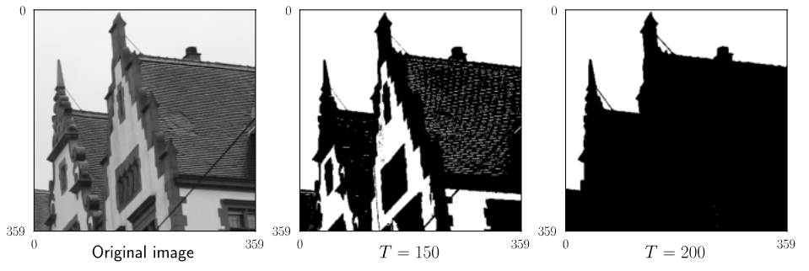
Point Operators
Thresholding

Slide 21
Point Operators
Thresholding: Otsu’s Method
An automatic image thresholding technique that finds an optimal threshold value that minimizes the variance within the two resulting groups of pixels (foreground and background).
- S1: Compute the histogram of the grayscale image, representing pixel intensity distribution.
- S2: Calculate the total variance of the image and test all possible threshold values (0 to 255 for an 8-bit image).
- S3: For each threshold, split the histogram into two classes and compute the "within-class variance."
- S4: Select the threshold that minimizes this variance (or equivalently, maximizes the "between-class variance").
Ref: Nobuyuki Otsu (1979), A Threshold Selection Method from Gray-Level Histograms

Slide 22
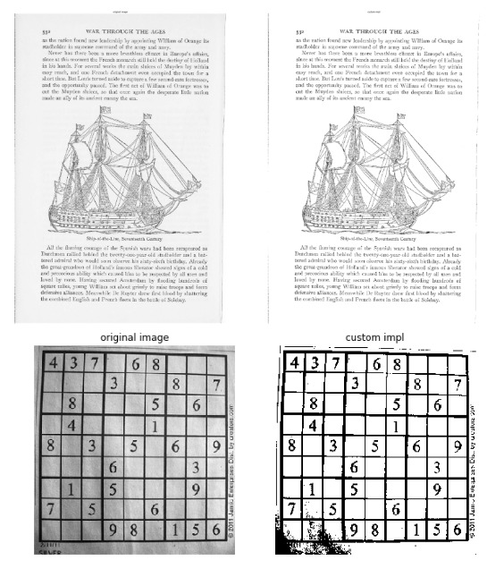
Point Operators
Thresholding: Otsu’s Method
Ref: https://en.wikipedia.org/wiki/Otsu%27s_method

Slide 23
Point Operators
Thresholding: Otsu’s Method
Advantages
- Automatic Thresholding: Doesn’t require manual input.
- Simplicity: The algorithm is straightforward to implement.
- Effective for Bimodal Histograms: Works well when the image has a clear background/foreground distinction.
- Robustness: Performs reliably on images with consistent lighting.
Disadvantages
- Assumes Bimodal Distribution: Struggles when images don’t have a clear two-class separation in the histogram.
- Sensitive to Noise: Noise or uneven illumination can distort the histogram, leading to suboptimal thresholds.
- Global Threshold Limitation: May fail on images with varying lighting or complex backgrounds.
- Grayscale Only: Doesn’t directly handle color images without preprocessing.

Slide 24
Point Operators
Linear Filters

Slide 25
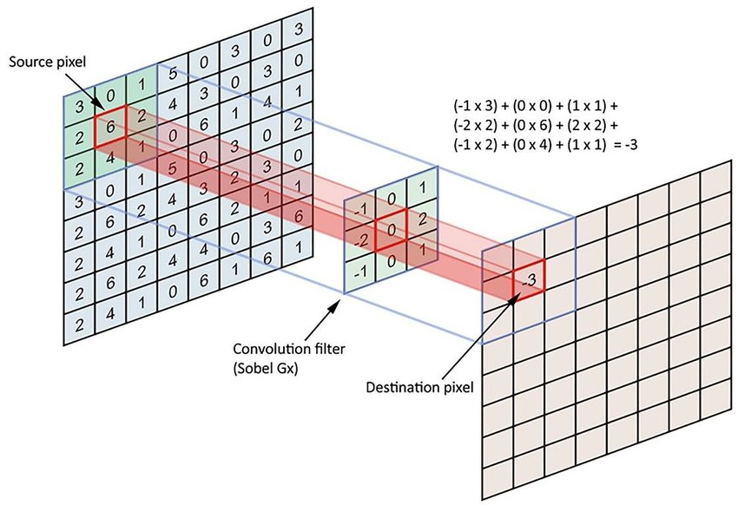
Linear Filters
What is linear filtering?
Linear filtering is the filtering method where the value of output pixel is linear combinations of the neighboring input pixels.

Slide 26
Linear Filters
Examples
- Mean/Average Filter
- Gaussian Filter
- Edge Detection Filter
- Motion Blur Filter
- Convolution Filter

Slide 27
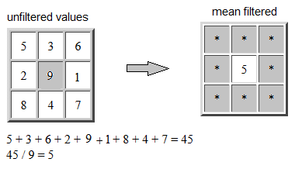
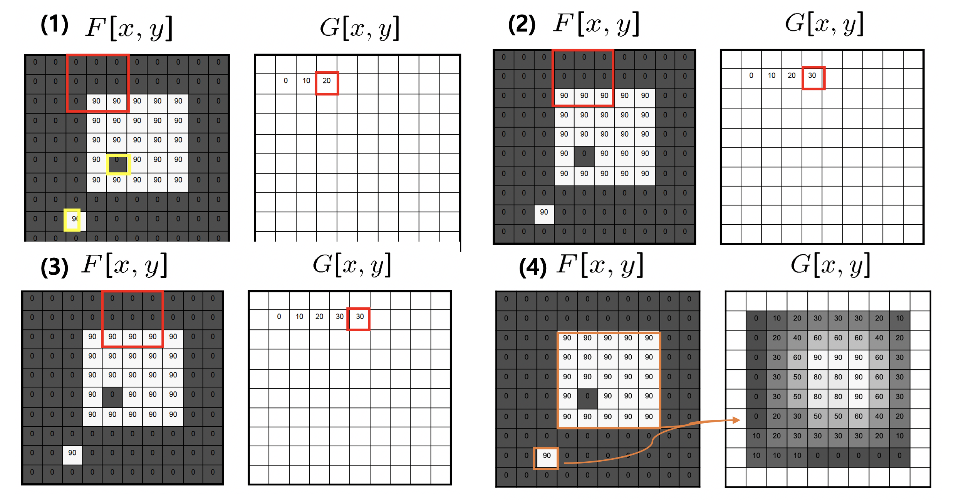
Linear Filters
Mean/Average Filter

Slide 28
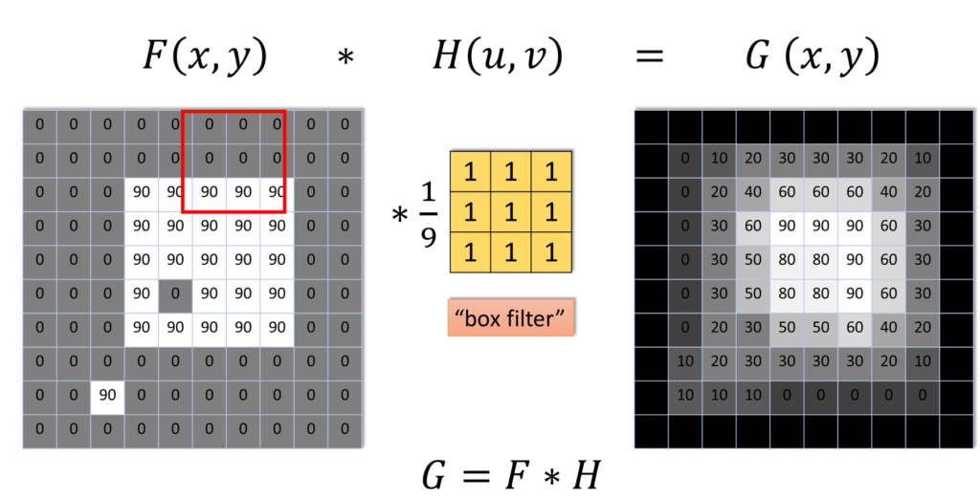
Linear Filters
Mean/Average Filter

Slide 29
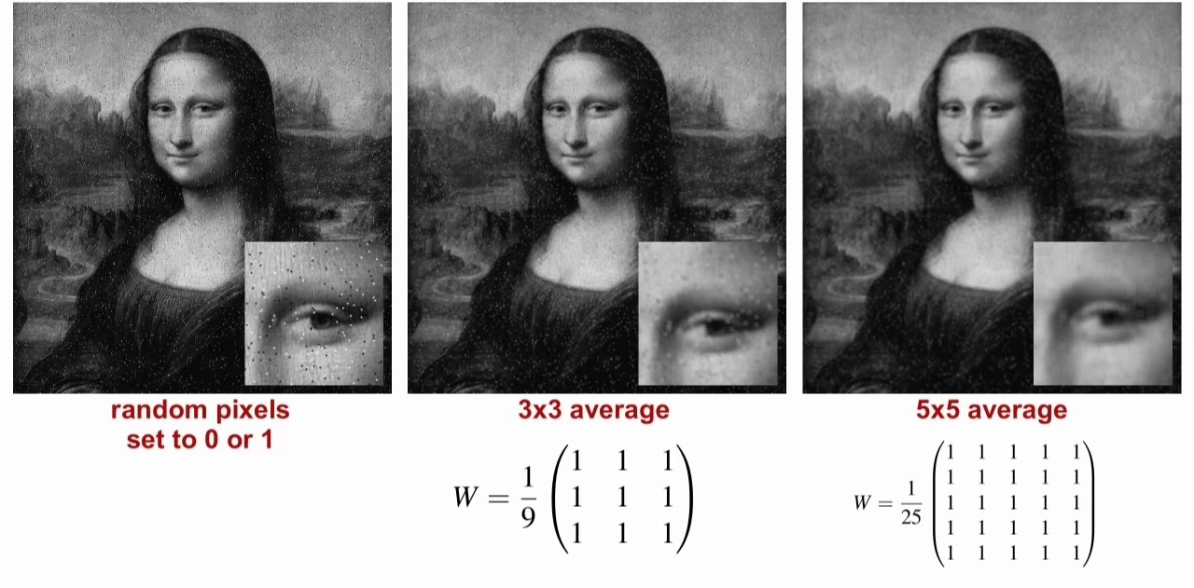
Linear Filters
Mean/Average Filter

Slide 30
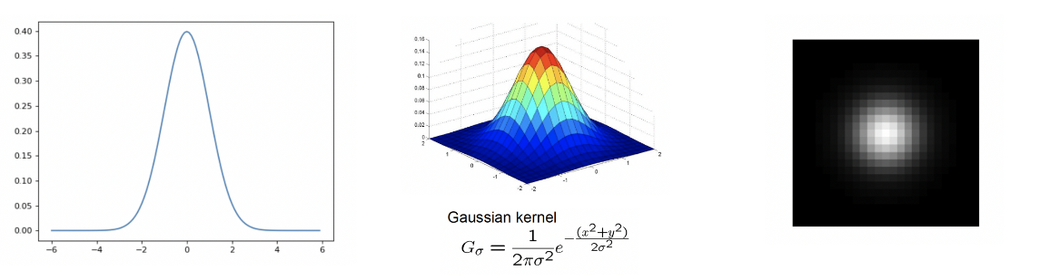
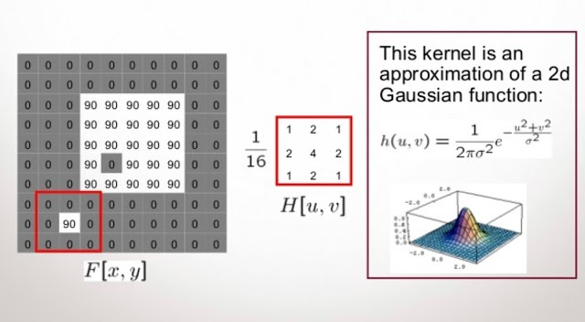
Linear Filters
Gaussian Filter

Slide 31
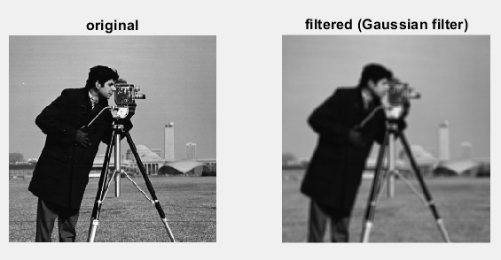
Linear Filters
Gaussian Filter

Slide 32
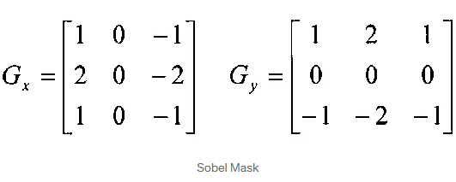
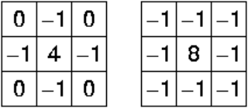
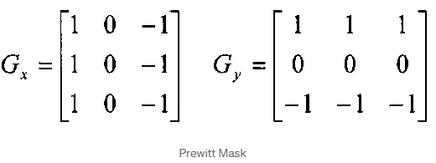

Linear Filters
Edge Detection Filter
Laplacian

Slide 33
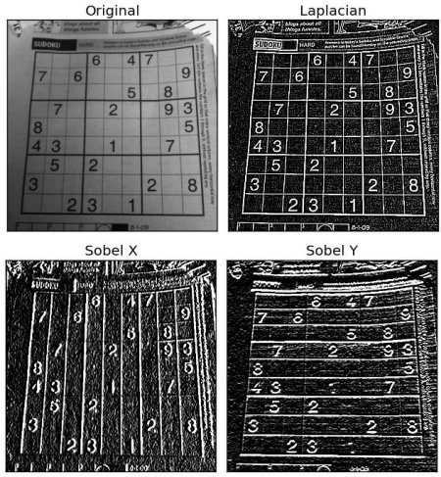
Linear Filters
Edge Detection Filter

Slide 34
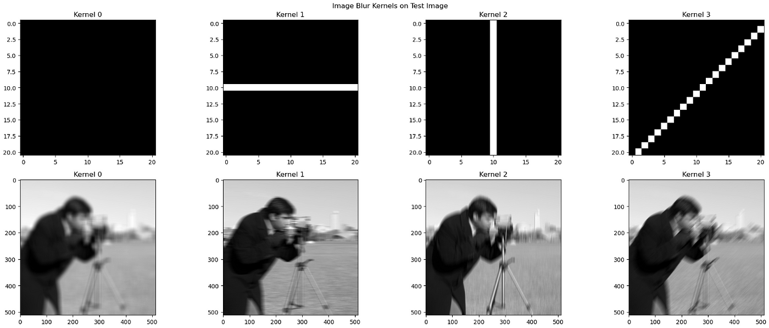
Linear Filters
Motion Blur Filter

Slide 35
Linear Filters
Convolution Filter

Slide 36

Linear Filters
Convolution Filter

Slide 37
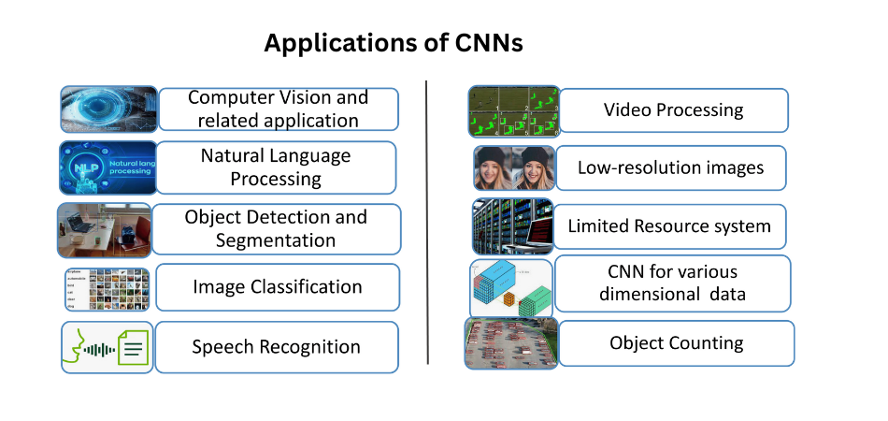
Linear Filters
Convolution Filter

Slide 38
Point Operators & Linear Filters
Practice
- Point Operators
- Linear Filters

Slide 39
Thank You
anhtl@ut.edu.vn

